Slide 1
Airbnb Data Challenge
Introduction
Sanity Check
Data Exploration
Model Results
Conclusion
Notes:
Title less technical

Slide 2
Introduction
The goal of this analysis is to identify opportunities to increase successful guest-host matching in Rio de Janeiro using the datasets provided.

Slide 3
Overview of Datasets
Contacts:
There are 27,887 unique inquiries with 11,588 bookings, 14 variables
Inquiries are made through 3 channels: Contact me, Book it, and Instant book
The inquiry time varies from 01/01/2016 to 06/30/2016, lead time of these inquiries ranges from 0 - 803 days
The check in dates varies from 01/01/2016 to 05/01/2018, and length of stay ranges from 1 - 365 days
Inquiries are made by either new bookers or past bookers for 1 - 16 guests
The total number of interactions between guest and host ranges from 1 - 410
Listings:
There 13038 unique listings with 4 variables
There are 3 room types for listings: Entire home/apt, private room and shared room
Listings are located in 68 neighborhoods
The number of reviews for listings ranges from 0 -268
Users:
There are 31457 users after dropping 68 duplicated ones, with 3 variables
Users are from 121 unique countries with profile length ranges from 0 - 1442

Slide 4
Sanity Check
Assumptions
Observations and Treatments
Merge data
Overview of data after cleaning

Slide 5
Assumptions
Contacts
Inquiry/reply/accept/book timestamps:
ALL channels:
Inquiry time ≤ reply time ≤ accept time ≤ book time
All accepted inquiries must be replied
All booked inquiries must be accepted
Check in time ≤ check out time
Book it:
Accept time = book time
Instant book:
Inquiry time = reply time = accept time = book time
Guest size ≥ 1, total number of interactions ≥ 1, and message length ≥ 0
Listings:
Number of reviews ≥ 0
Users:
No duplicated users
Profile length ≥ 0

Slide 6
Observations and Treatments
Contacts
Inquiry/reply/accept/book timestamps:
ALL channels:
452 inquiries where the inquiry time > reply time with lags between 1-70 seconds
Updated the reply time to be the same as inquiry time
Book it:
257 inquiries accepted but not booked,
Updated the book time to be the same as accept time
152 inquiries where booked but not accepted or book time ≠ accepted time
Updated the book time to be the same as accept time
Instant book:
40 inquiries where inquiry, reply, accept, and booking did not happen at the same hour (allowed the latency of an hour)
Filtered out these inquiries assuming they are erroneous records

Slide 7
Observations and Treatments (Cont.)
Contacts:
Guest size:
4 inquiries where number of guests is 0:
Filtered out these inquiries assuming they are erroneous records
Listings:
Number of reviews:
41 listings with negative number of reviews:
Replaced with medium
Users:
Duplicates:
68 users with duplicate ids:
Remove from analysis

Slide 8
Merge Data
Guest information:
Merged guest information from ‘Users’ to ‘Contacts’, by ‘id_guest_anon’ in ‘Contacts’ and ‘id_user_anon’ in ‘Users’
Host information:
Merged host information from ‘Users’ to ‘Contacts’, by ‘id_host_anon’ in ‘Contacts’ and ‘id_user_anon’ in ‘Users’
Listing information:
Merged listing information from ‘Listings’ to ‘Contacts’, by ‘id_listing_anon’ in both datasets

Slide 9
Overview of Data After Cleaning
Before/After | Inquiries | Replied | Accepted | Booked
Contact me | 12,828/12,814 | 11,659/11,645 | 5,482/5,476 | 911/909
Book it | 8,366/8,352 | 7,503/7,492 | 4,240/4,237 | 3,983/3,980
Instant book | 6,693/6,682 | 6,693/6,682 | 6,693/6,682 | 6,693/6,682
Total | 27,887/27,848 | 25,855/25,819 | 16,415/16,395 | 11,587/11,571
27,848 valid inquiries were made by 22,540 unique guests
The inquiry time varies from 01/01/2016 to 06/30/2016
Inquiries were made for 12,812 unique listings of 8,956 unique hosts

Slide 10
Data Exploration
Univariate analysis
Bivariate analysis
Multivariate analysis

Slide 11
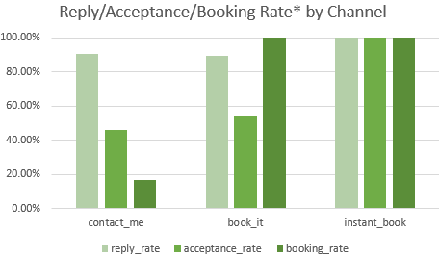
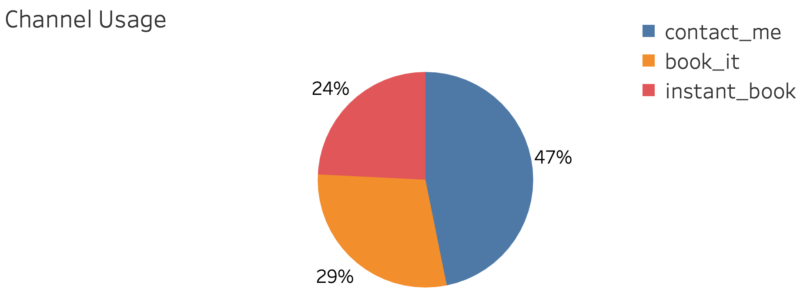
Overview of 3 Channels
Almost half (47%) of the inquiries are made through Contact Me channel
The rest of the inquiries were made in Book It (29%) and Instant Book (24%)
Contact Me and Book It does not differ much in terms of reply rate, 91% vs. 89%, and acceptance rate 46% v.s. 54%
However, Contact Me channel has a low booking rate (17%)
*Reply rate = # inquiries replied/# inquiries made, acceptance rate = # inquiries accepted/# inquiries replied, booking rate = # inquiries book/# inquiries accepted.

Slide 12
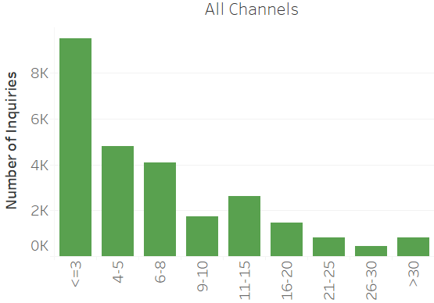
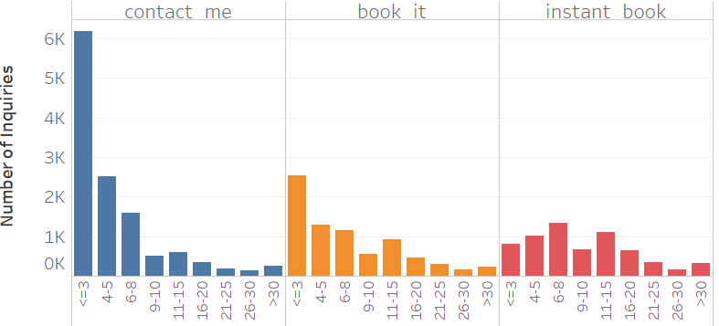
Univariate Analysis - # Interactions
Majority of the inquiries in Contact Me (50%) channel and Book It (33%) have no more than 3 interactions
Contact Me channel has a lower average interactions (6) than Book It (9)

Slide 13
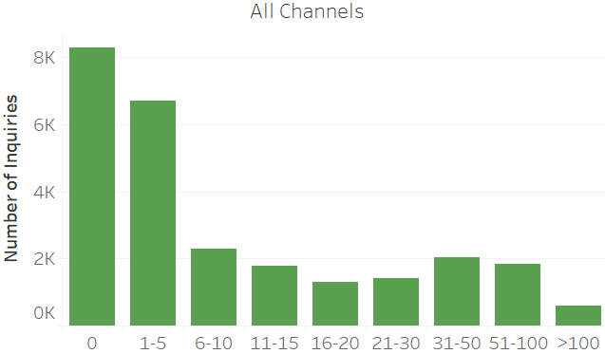
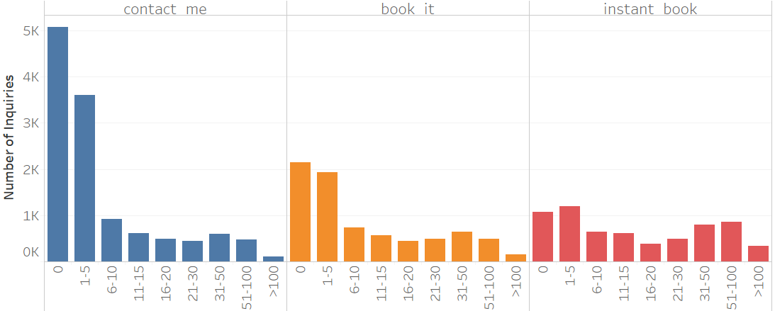
Univariate Analysis - # Reviews
Most (57%) of the listings have no more than 5 reviews for all channels
When a listing has no reviews, an inquiry to this listing is more likely to be made in the Contact Me channel
Listings with less than 5 reviews are most common for contact me and book it channels, whereas listings with 31 - 100 reviews are popular in instant book as well
Majority (55%) of inquiries for listings with more than 100 reviews are made in instant book channel
Inquiries made through instant book channel have more reviews on average

Slide 14
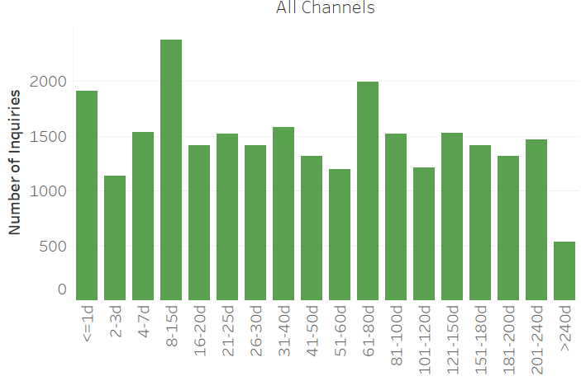
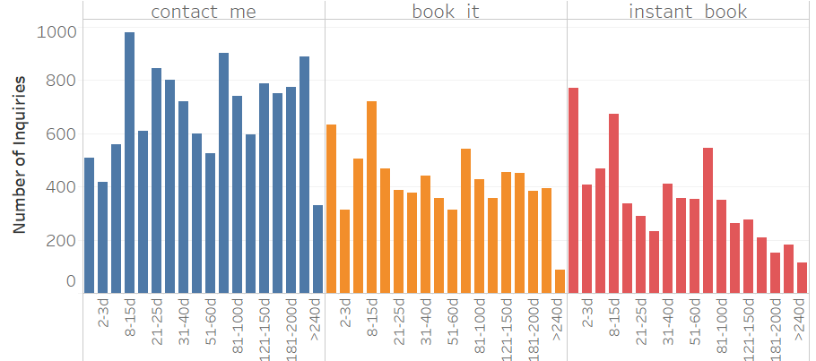
Univariate Analysis - Lead time
Lead time ranges from 0 - 430 days for all inquiries, where the majority (75%) are shorter than 62 days
Contact me channel has longer lead time(82 days) and instant book has shorter lead time (55 days) on average

Slide 15
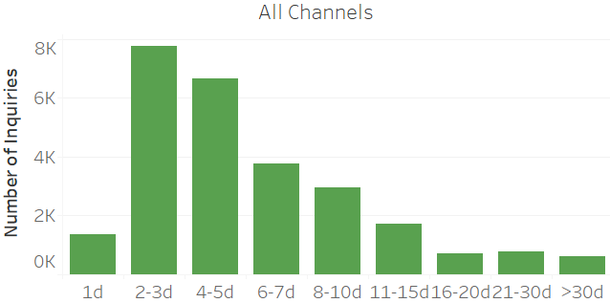
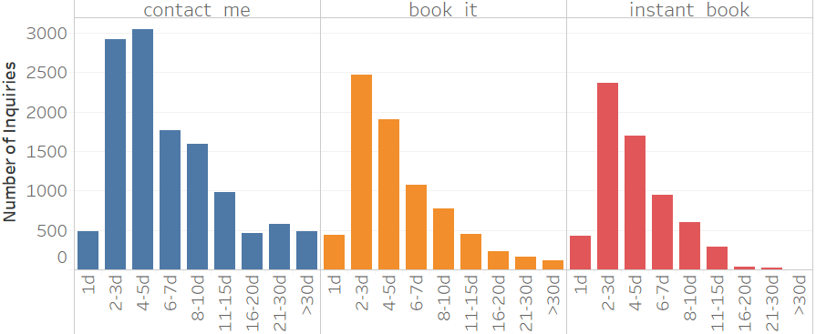
Univariate Analysis - Duration of stay
The majority (55%) of the inquiries are for 2-5 days of stays for all channels
When the length of stay is longer than 15 days, this inquiry is more likely to be made in Contact Me channel as 73% of all such inquiries fall under Contact Me channel
Contact me channel has longer length of stay than other channels on average
Notes:
Change 2nd point

Slide 16
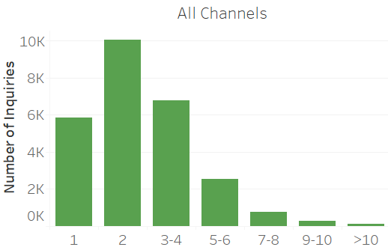
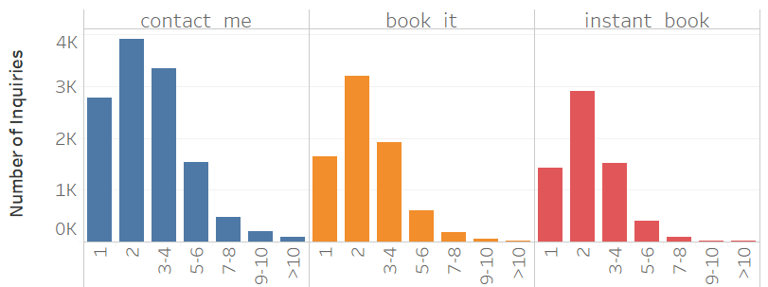
Univariate Analysis - Guest size
86% of the inquiries are for no more than 4 guests and 38% of the inquiries are for 2 guests for all channels
Inquiries for 2 guests are most common for 3 channels
Contact me has higher average guest size (3) than instant book
Notes:
Add percentage to majority
Average diff

Slide 17
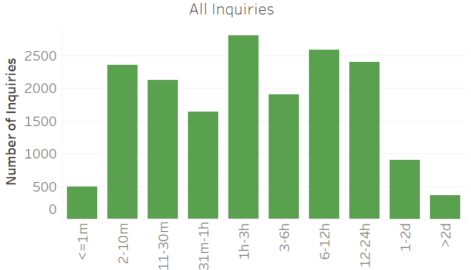
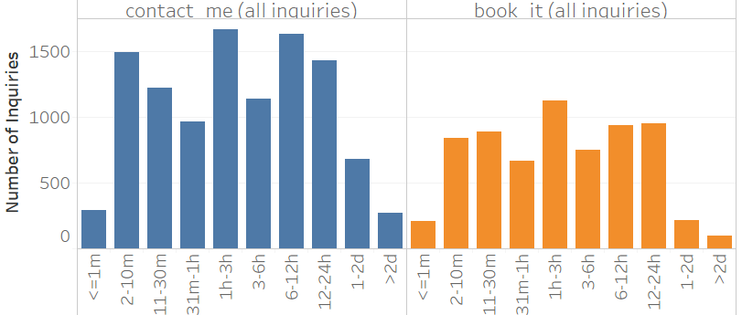
Univariate Analysis - Reply time*
95% of the inquiries in both channels are replied within 1 day
14% of the inquiries are replied with in 1 - 3 hours
Longest reply time is 6 days for contact me channel 410 days for book it channel
Reply time in contact me channel is longer than book it channel on average
*Inquiries where reply time = accept time are filtered out

Slide 18
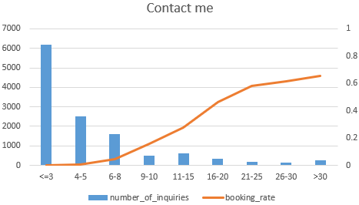
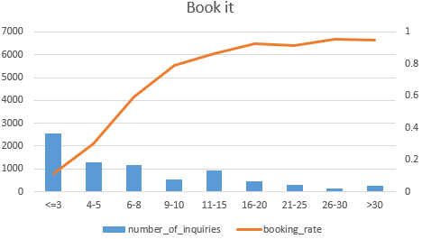
Bivariate Analysis - # Interactions* and Booking Rate
Majority (65%) of the inquiries that have no more than 3 interactions fall under Contact Me channel
More interactions are associated with higher booking rate for both channels, while the effect is stronger for book it channel
After 25 interactions for contact me channel and after 20 interactions for book it channel, the increase starts to slow down
* The dataset provided has no flag for us to differentiation when an interaction has been made, therefore interactions include interactions both before and after a booking has been made.
Notes:
2nd point: For all inquiries or successful?
Inflextion point

Slide 19
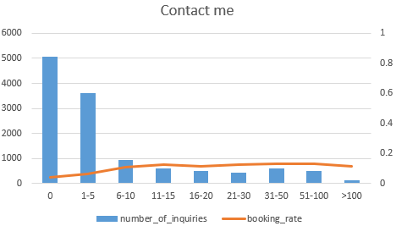
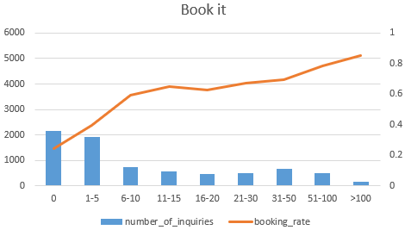
Bivariate Analysis - # Reviews and Booking Rate
70% inquiries made in contact me channel were for listings with no more than 5 reviews with booking rate less than 7%
53% inquiries made in book it channel were for listings with no more than 5 reviews with booking rate less than 40%
Having at least 11 reviews drives booking rate up to 13% in contact me channel and 65% in book it channel
Having more than 50 reviews drives booking rate up to 78% and reaches 85% when review > 100, in book it channel
However, booking rate starts to decline after 100 reviews for contact me channel
Notes:
Review more than 5 provide higher success rate for both channel, beyond that reciew positively infect

Slide 20
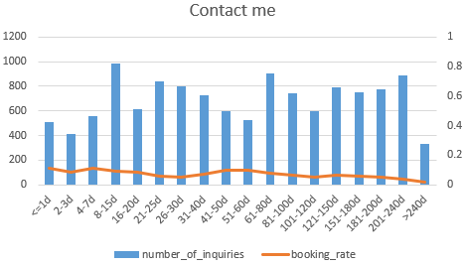
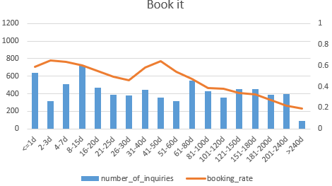
Bivariate Analysis - Lead time and Booking Rate
27% of inquiries made within 1 day before check in are in contact me channel, and 33% in book it channel
For book it channel, inquiries made closer to checkin date have higher booking rate overall, except for inquiries made 41 - 50 days before check in, whose success rate (65%) is the same as inquiries made 2 -3 days before check in
Lead time has no strong impact on success for contact me channel

Slide 21
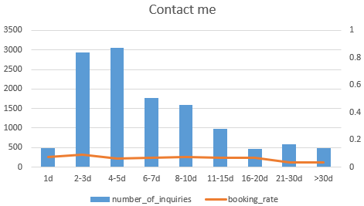
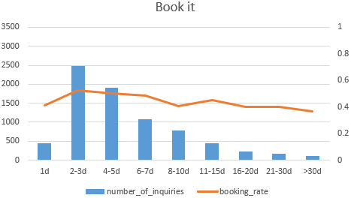
Bivariate Analysis - Duration of Stay and Booking Rate
The majority (61%) of trips longer than 7 days are in contact me channel
Trips of 2 or 3 days are most likely to be booked for both channels
The longer the stay, the lower the success rate for Book it channel
Success rate starts to decline when trips are longer than 7 days for book it channel

Slide 22
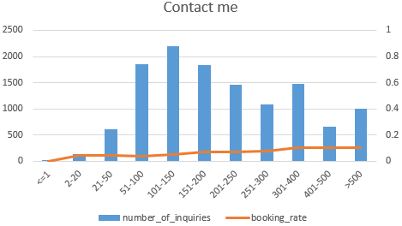
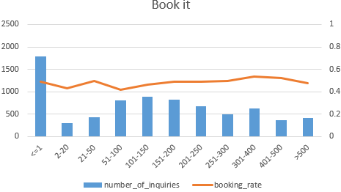
Bivariate Analysis - Message Length and Booking rate
18% of the inquires in contact me channel contains 100 -150 characters, 23% of the inquiries on book it channel contains less than 1 characters
Longer(>50 characters) messages tend to be sent in contact me channel, short (<20 characters) tend to be sent in book it channel
Longer messages are associated with higher booking rate for contact me channel, but the increase is slow
For book it channel, messages with either 20 - 50 or 300 - 400 characters are most likely to be booked, otherwise there is not a obvious trend between message length and booking rate

Slide 23
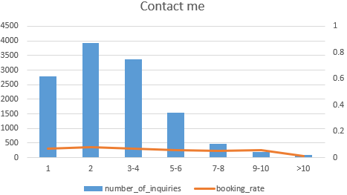
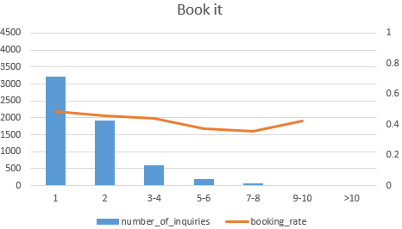
Bivariate Analysis - Guest Size and Booking Rate
The majority (36%) of single guests chose book it channel, whereas contact me channel dominates over other guest sizes
Inquiries for single guest have the highest success rate for in book it channel
More guests are associated with low booking rate for both channels

Slide 24
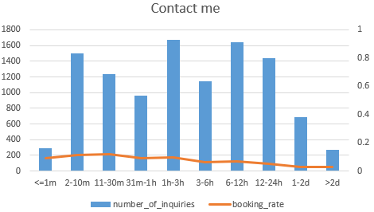
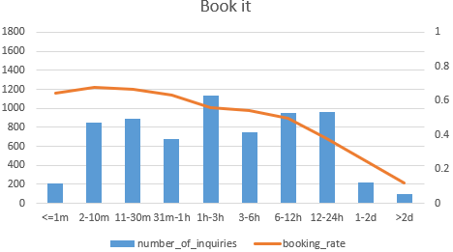
Bivariate Analysis - Reply Time* and Booking Rate
Contact me channel dominates over all reply time bins
Longer reply time is associated with lower booking rate for both channels, whereas the decrease is much stronger in book it channel
Inquiries replied within 30 mins are most likely to be booked for both channels
In book it channel, replies time longer than 1 hour drags booking rate below 70%, those longer than 12 hours drags booking rate below 50%
*Inquiries where reply time = accept time are filtered out

Slide 25
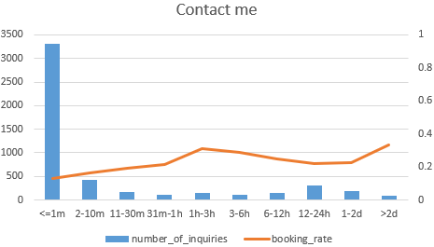
Bivariate Analysis - Accept time and Booking rate
For contact me channel, inquiries accepted within 1-3 hours after reply are most likely to be booked
Longer accept time tends to drive up the booking rate, longer accept time might could mean that the host spent more time to interact with the guest before accepting the request and therefore guests are more likely to make the booking

Slide 26
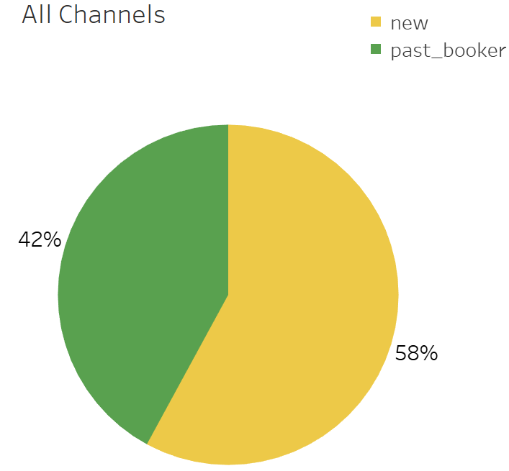
Bivariate Analysis - User stage and Booking rate
[# of inquiries] reply/accept/book rate* | Contact Me | Book It | Instant Book
New Booker | [8,793] 91%/46%/15% | [4,296] 89%/52%/100% | [2,802] 100%/100%/100%
Past Booker | [4,005] 90%/47%/22% | [4,050] 90%/56%/100% | [3,881] 100%/100%/100%
The majority (56%) of new users tend to choose contact me channel
Reply rate does not differ much between new and past booker among 3 channels
Accept rate of past bookers is slightly higher than new bookers for Contact Me and Book It channel
Book rate of past bookers is 47% higher than new booker (22% v.s. 15%) in Contact Me channel
*Reply rate = # inquiries replied/# inquiries made, accept rate = # inquiries accepted/# inquiries replied, book rate = # inquiries book/# inquiries accepted.

Slide 27
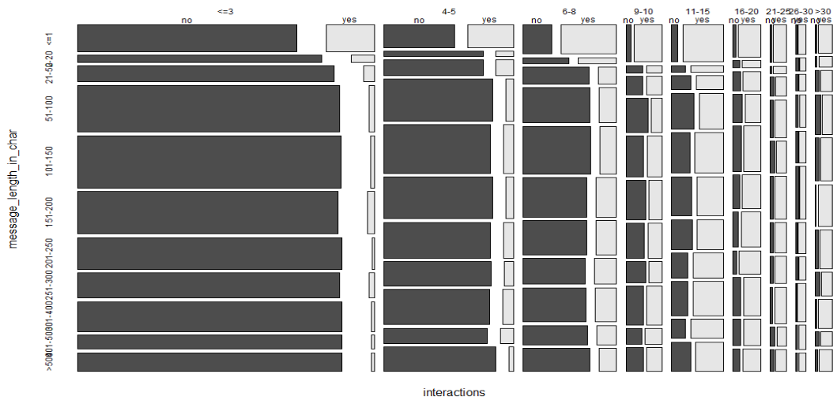
Multivariate Analysis - Message + # Interactions
Regardless of message length, when # of interactions >11, it will lead to more bookings than non booking.
When # of interactions > 11, it can make up for the lack in message length, and turn an inquiry into a successful booking.
When message length is >20, more interactions are needed in order to turn an inquiry into a successful booking. This could be due to the fact that a longer message reflects the complexity of a stay request, therefore needing more interactions between the host and the guest in order for it to be successful.

Slide 28
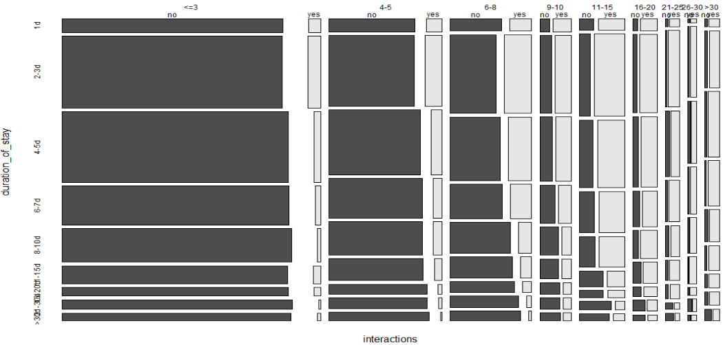
Multivariate Analysis - Duration of stay + # Interactions
Days of stay ≤ 3 regardless of number of interactions, will lead success rate to double
However, when number of interactions is more than 20, it no longer matters how long the stays are, which means, more than 20 interactions might be able to sufficiently make up for the long stays.

Slide 29
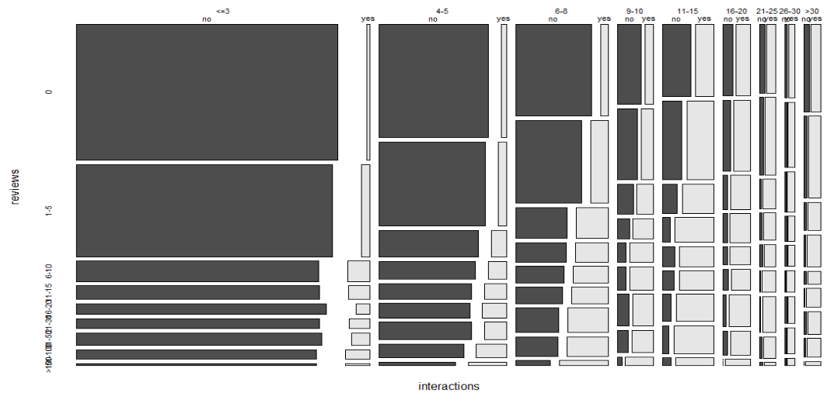
Multivariate Analysis - Review + # Interactions
Number of reviews > 5, regardless of number of interactions, will double the success rate
However, when number of interactions is more than 20, it no longer matters when an inquiry has fewer or more than 5 reviews, which means, more than 20 interactions might be able to sufficiently make up for the lack of reviews.

Slide 30
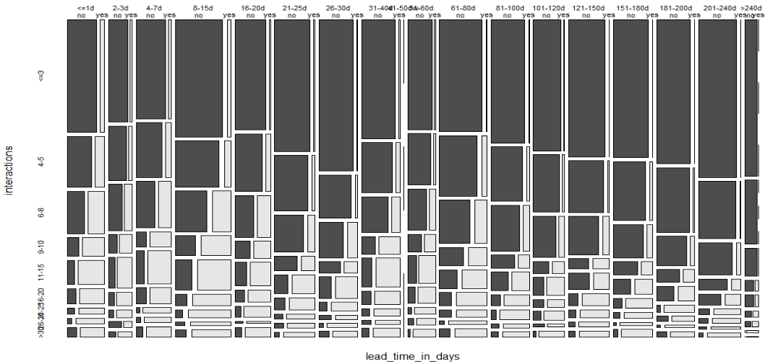
Multivariate Analysis - # Interactions + Lead Time
When lead time ≤ 15 days, the number of successes doubled regardless of interactions
Regardless of lead time, when # of interactions >11, it will lead to more bookings than non booking. Therefore, having more than 11 interactions can make up for the long lead times, and turn an inquiry into a successful booking.

Slide 31
Model Results
Inquiries usually follow the steps of being replied -- accepted -- booked. Therefore, three models were built each to find:
Drivers of Reply
Drivers of Acceptance
Drivers of Confirmation for Booking

Slide 32
Drivers of Reply
Logistic Regression model is used to predict what drives hosts' reply for all inquiries made in Contact Me and Book It channel
Important drivers of hosts’ reply are:
Number of reviews for the listing
First message length
Lead time
Inquiries in Instant Book channel and inquiries where reply timestamp equals accept timestamp are excluded.
Model performance:
AUC score: 0.64
Accuracy: 0.88

Slide 33
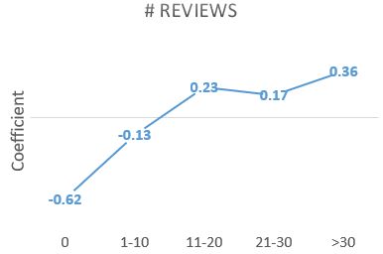
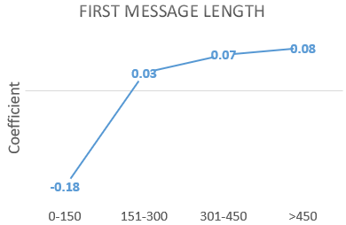
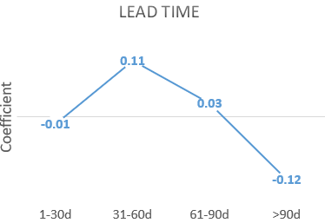
How do # reviews, first message length, and lead time drives reply
Having more than 10 reviews significantly increases the probability of reply
Hosts who reply more are matched for more bookings and therefore have more reviews
Can consider to promote new hosts so that they can have more chance to get reviews and increase bookings
Messages with more than 150 characters are likely to be replied, messages too short(0-150 characters) have a lower chance to be replied.
Short messages give too little information for hosts to reply to the inquiries.
Can encourage guests to send longer message (>150 characters) and prompt for desired information of hosts
Inquiries with long lead time (>90d) have a lower chance to be replied.
Inquiries made too far ahead of check-in may increase the difficulty for hosts to arrange for the trip.

Slide 34
Drivers of Acceptance
Logistic Regression model is used to predict what drives hosts' acceptance for replied inquiries in Contact Me and Book It channel
Important drivers of guests’ confirmation are:
Number of interactions
Number of reviews
Lead time
Days of stay
Reply time
First message length
Guest size
Inquiries in Instant Book channel and inquiries where reply timestamp equals accept timestamp are excluded.
Model performance:
AUC score: 0.79
Accuracy: 0.76

Slide 35
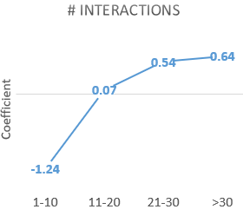
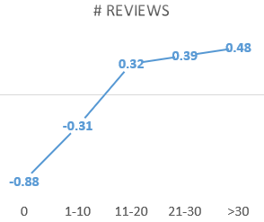
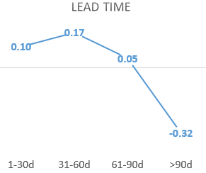
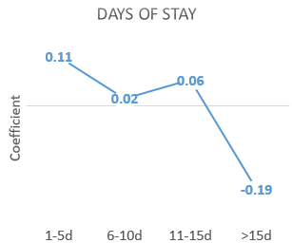
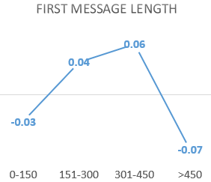
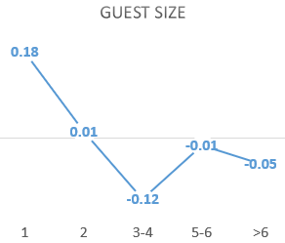
How does each driver impact acceptance
More than 20 interactions significantly increases the probability of acceptance, and having less than 10 interactions decreases it
Hosts whose listings have more than 10 reviews are more likely to accept the inquiries than those whose listings have less than 10 reviews
Inquiries made less than 90 days before check-in are more likely to be accepted
Inquiries for less than 15 days of stay are likely to be accepted
Inquiries with message between 150 and 450 characters are more likely to be accepted
Inquiries for single guest are most likely to be accepted, and inquiries for more than 2 guests are less likely to be booked

Slide 36
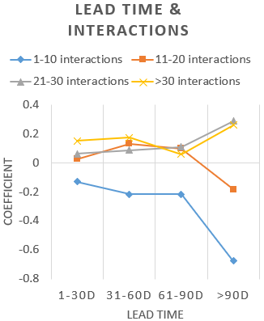
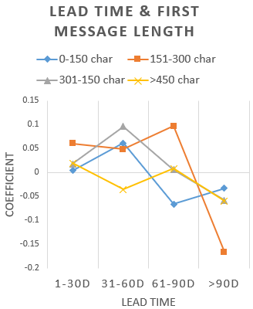
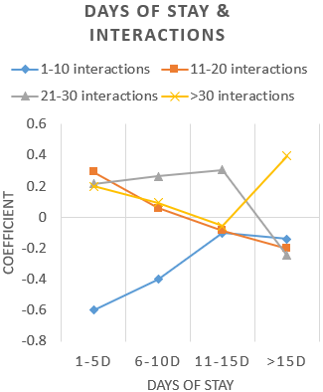
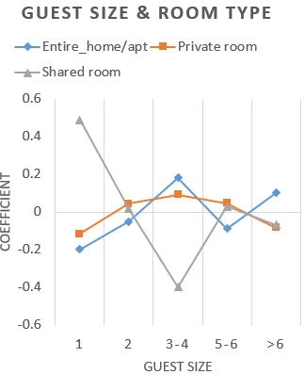
Interactions between some variables
Having less than 10 interactions decreases the probability of acceptance across all lengths of stay
When stay <= 5 days, interaction between 11 - 20 benefits acceptance the most
When stay between 6 - 15 days, interaction between 21 - 30 benefits acceptance the most
When stay > 15 days, need more than 30 interactions to drive acceptance
When guest size = 1, inquiries for a shared room are most likely to be accepted
When guest size = 2, inquiries for an entire_home/apt are less likely to be accepted
When guest size between 3 - 4 or > 6, inquiries for an entire_home/apt are most likely to be accepted
When guest size between 5 - 6, inquiries for an entire_home/apt are less likely to be accepted
Having more than 10 interactions drives up the probability of acceptance from negative to positive for lead times < 90 days
For inquiries with lead time >90 days, need more than 20 interactions to drive acceptance
When lead time between 31 - 60 days, sending long messages(> 450 char) drags down acceptance rate
When lead time between 61 - 90 days, sending short messages(< 150 char) drags down acceptance rate

Slide 37
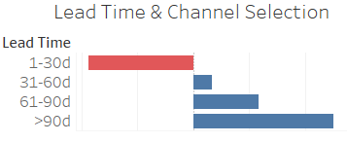

Additional findings
Probability
Slope = -0.2506
Inquiries made within 30 days before check-in are more likely to be accepted in Book it channel
Inquiries made more than 30 days before check-in are more likely to be accepted in Contact Me channel
Reply Time
Each additional minute decreases the probability of acceptance
Hosts who reply sooner are more likely to accept the inquiries

Slide 38
Drivers of Confirmation for Booking
Important drivers of hosts’ acceptance are:
Number of interactions
Number of reviews
User stage
Days of stay
Accept time
Lead time
Logistic Regression model is used to predict what drives guests’ confirmation for accepted inquiries in Contact Me channel
Model performance:
AUC score: 0.88
Accuracy: 0.89

Slide 39
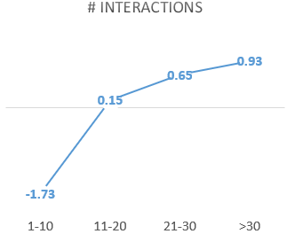
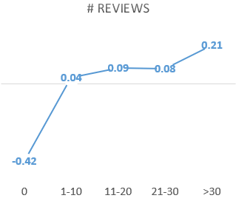


How does each driver impact confirmation for booking
More than 20 interactions significantly increases the probability of confirmation from hosts, and having less than 10 interactions decreases it
Guests are less likely to confirm the booking if the listings have 0 reviews but more likely to confirm those with more 30 reviews
Inquiries for less than 10 days of stays are more likely to be confirmed, but inquiries for more than 15 days of stays are less likely to be confirmed
Guests are less likely to confirm accepted inquiries if they are made more than 90 days before check-in

Slide 40



Interactions between some variables
Having more than 10 interactions drives up the probability of confirmation from negative to positive for lead time within 90 days
For inquiries with lead time >90 days, need more than 20 interactions to drive confirmation
When message length <= 150 char, 21-30 interactions benefits confirmation the most
When message length between 151 - 300 char, > 30 interactions benefits confirmation the most
When message length between 301 - 450 char, need more than 20 interactions to drive confirmation
When message length > 450 char, 21-30 interactions doesn't benefit confirmation but 11 - 20 does the most
When lead_time <= 60 days, long messages(>450 char) benefits confirmation
When lead_time between 60 - 90 days, long messages(>450 char) don't benefits confirmation, but intermediate length messages (301- 450 char) do
When lead_time >90 days, only messages between 150 - 300 char benefit confirmation

Slide 41

Additional findings
Accept time
Probability
Slope = 0.0656
Accept time
Past bookers are more likely to confirm bookings after the inquiries are accepted, may because of their trust in the process and the platform
Longer accept time increases the probability of confirmation
Longer accept time may be the result of more interactions between hosts and guests, and therefore guests are more likely to confirm the booking

Slide 42
Conclusion
Key metrics to monitor success
Segments doing well and segments could be improved
Opportunities in increasing the number of successful bookings
Recommendations

Slide 43
Key metrics to monitor success
Successful rate
Success rate = # successful bookings / # total inquiries
This metric monitors the overall performance of the booking funnel
Reply/acceptance rate/booking rate
Reply rate = # inquiries replied/# total inquiries
Acceptance rate = # inquiries accepted/# replied inquiries
Booking rate = # inquiries booked/# accepted inquiries
These metrics help track the success rate of each steps of the booking funnel
Average interactions per inquiry
Avg interactions per inquiries = # total interactions / # total inquiries
Interactions drive acceptance and confirmation regardless of long lead time, all duration of stay, and short first message
Review rate
Review rate = # inquiries that the guest left a review / # total inquiries
Reviews drives guests’ confirmation for booking, and exhibit hosts’ willingness to reply and accept

Slide 44

Segments doing well and segments could be improved
Airbnb is doing well in getting hosts to respond to inquiries
However, it needs to find opportunities in encouraging
hosts to accept the inquiries after responding to them
guests to book their accepted inquiries
Low acceptance and booking rate are related to long lead time, long duration of stay, and large guest size according to EDA and model results

Slide 45
Opportunities in increasing success rate of acceptance and booking
Since reply rate is already high enough (90%), Airbnb should focus on increasing acceptance rate and booking rate.
The following are observations from EDA and model results:
 | More interactions | More reviews | Channel selection for different lead times | Appropriate room types for different guest sizes | Appropriate first message lengths for different lead times
Increase acceptance rate | ✔ | ✔ | ✔ | ✔ | ✔
Increase booking rate | ✔ | ✔ |  |  | ✔

Slide 46
Recommendation 1
For inquiries with long lead time(>90 days) and/or long duration(>15 days):
Suggest the guests to
Use Contact Me channel, since inquiries with long lead times are more likely to be accepted in Contact Me channel
Send messages of proper length(150 - 300 char), which benefits confirmation for booking
Encourage hosts and guests to interact with each other as many times(>20) as possible so that they can be more familiar with each other can increase the chance of both acceptance and confirmation for booking
1
2
3
1: Refer to slide #37.
2&3: Refer to slide #40.

Slide 47
Recommendation 2
Guide guests to choose appropriate room types according to their guest sizes when making inquiries:
Shared room for single guest
Private room for 2 guests
Entire home/apt for over 3 guests
Since that hosts are more willing to accept the inquiries if so.*
*Refer to slide #36.

Slide 48
Recommendation 3
Since number of reviews are highly related to acceptance rate and booking rate in tha reviews give both guests and host confidence in the success of the booking*. Following suggestions can be helpful in driving up number of reviews:
For guests just joined Airbnb, promote their listings so that they are more likely to be booked and gain reviews.
In general, emphasize the importance of reviews to both hosts and encourage guests to leave a review after completing their trips.
*Refer to slide #35 & #39.

